Slide 1
Flux
Flux
A Rule-based Authorisation layer for WebGUI
Melbourne Perl Mongers Lightning Talk
Patrick Donelan, Wed Jun 11, 2008
pat@patspam.com http://patspam.com

Slide 2
Flux
WebGUI
demo.webgui.org

Slide 3
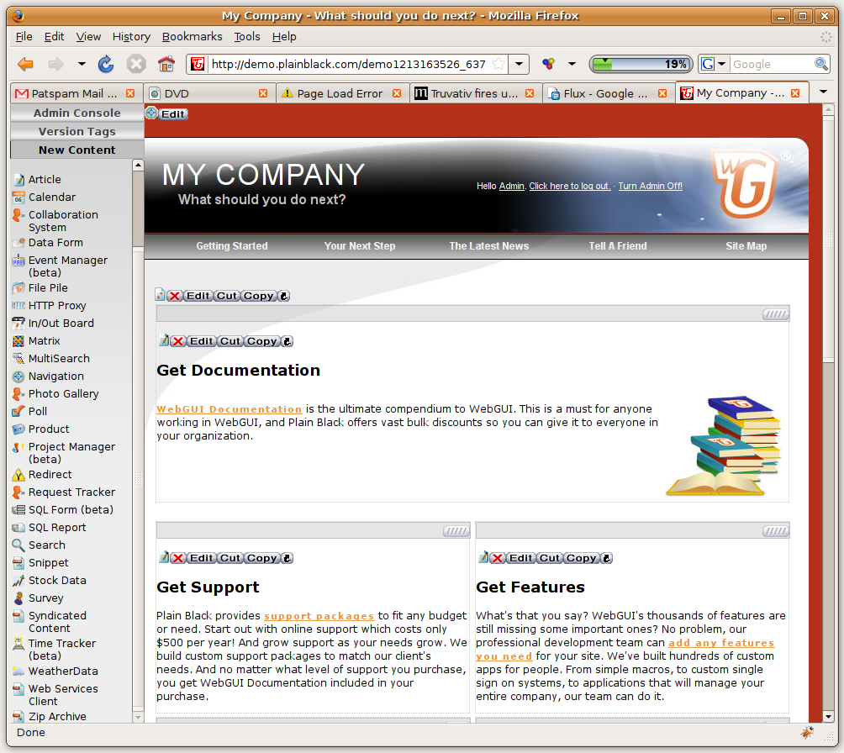
Flux

Slide 4
Flux
WebGUI Admin Console

Slide 5
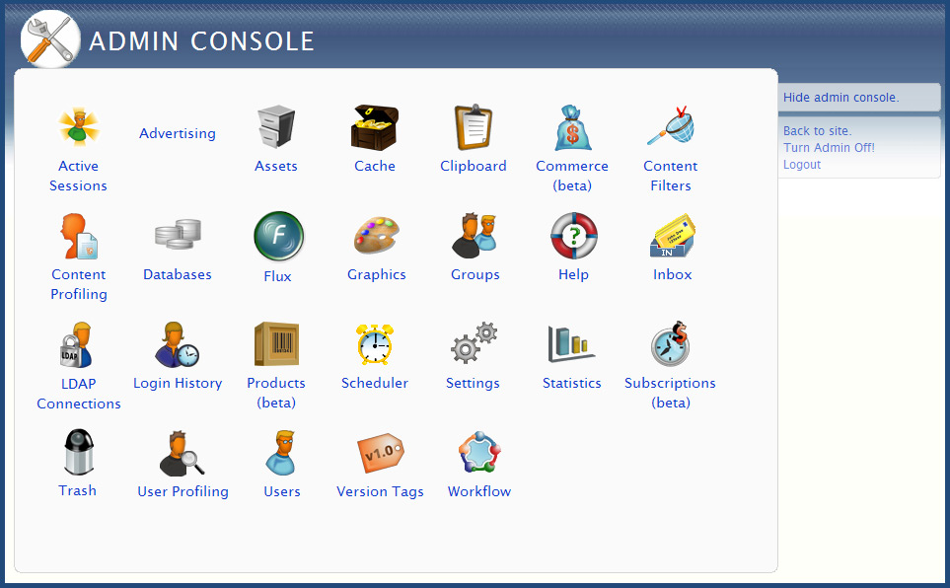
Flux

Slide 6
Flux
Authorisation

Slide 7
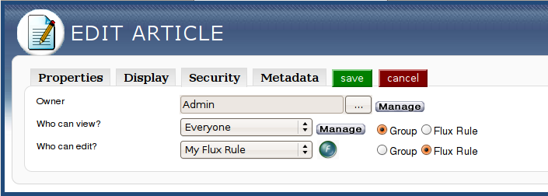
Flux

Slide 8
Flux
Flux Rules (ok!)‏

Slide 9
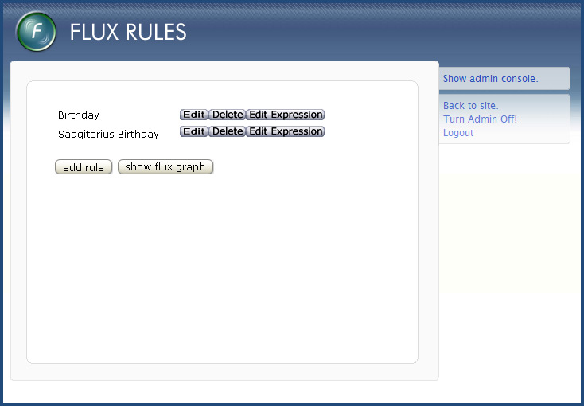
Flux

Slide 10
Flux
Flux Expressions

Slide 11
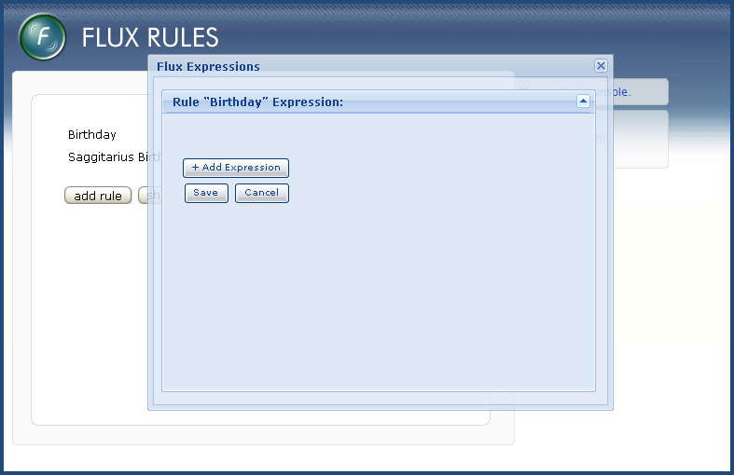
Flux

Slide 12
Flux
First Operand

Slide 13
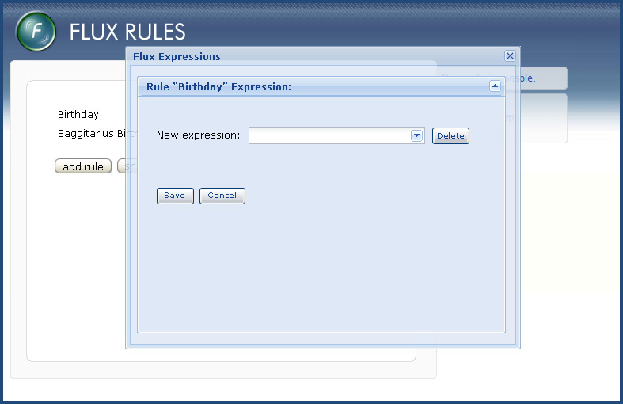
Flux

Slide 14
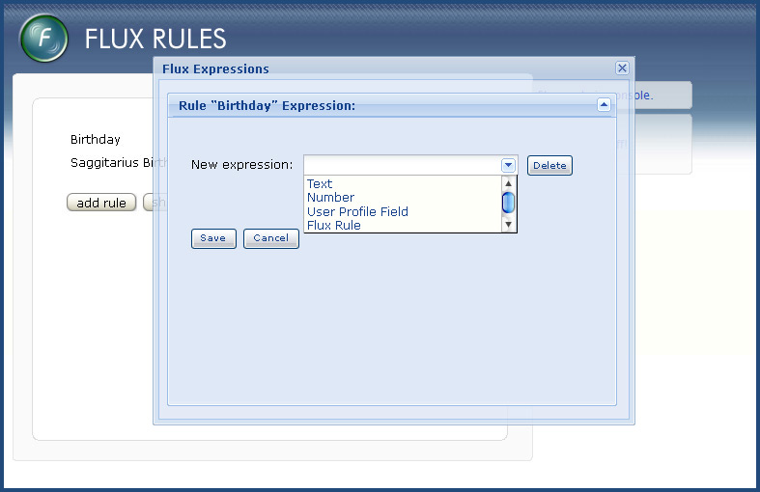
Flux

Slide 15
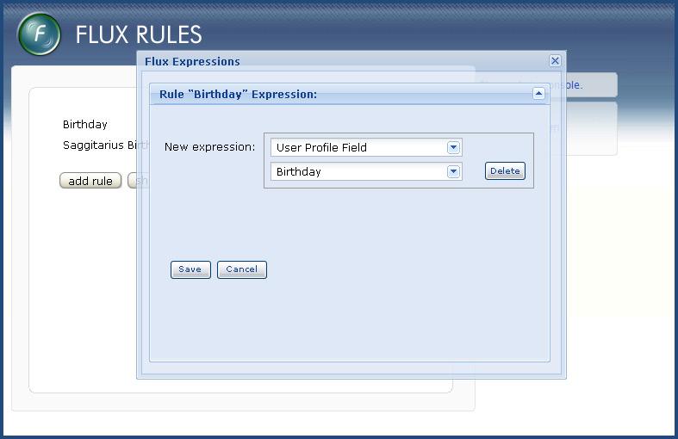
Flux

Slide 16
Flux
Operand Value Modifiers

Slide 17
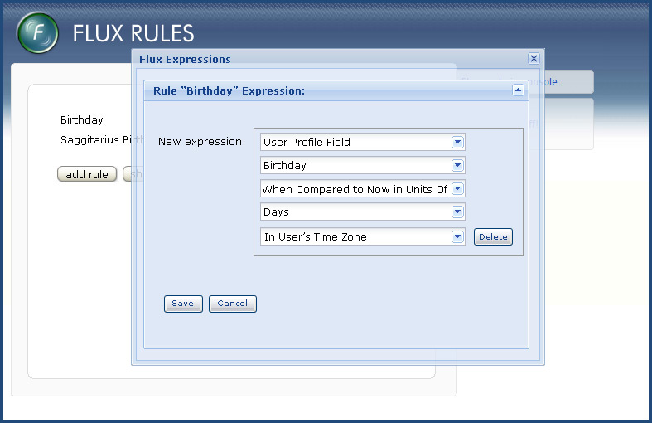
Flux

Slide 18
Flux
Binary Operators

Slide 19
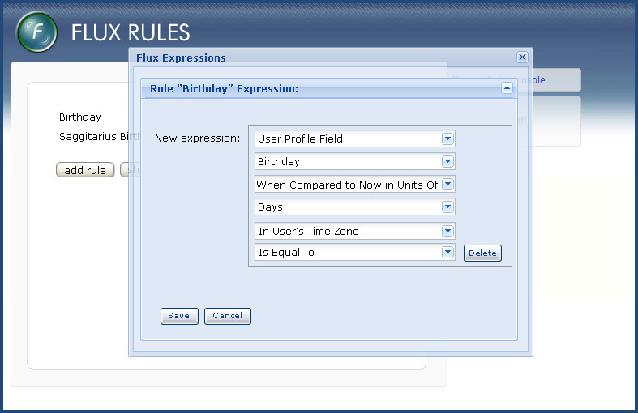
Flux

Slide 20
Flux
Second Operand

Slide 21
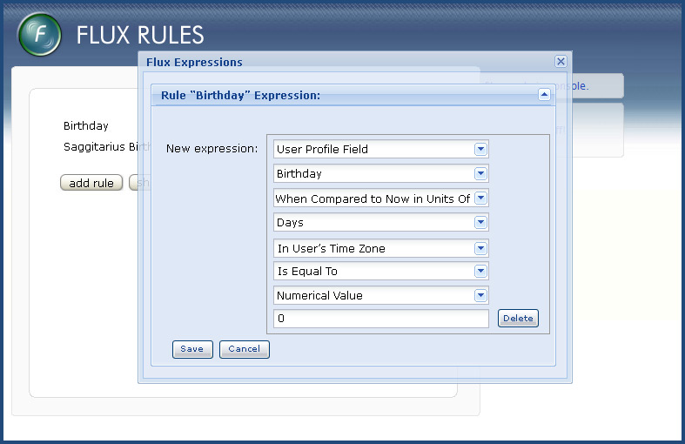
Flux

Slide 22
Flux
Combined Expressions

Slide 23
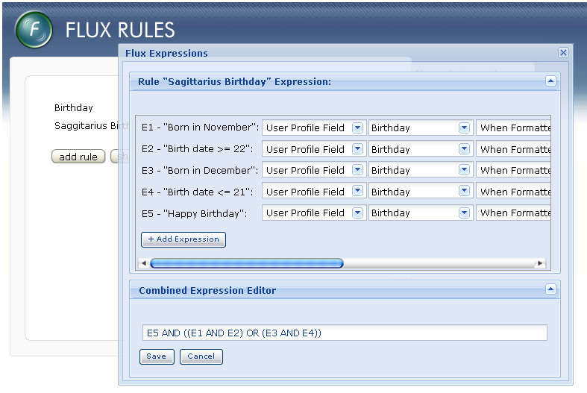
Flux

Slide 24
Flux
Workflow Triggers

Slide 25
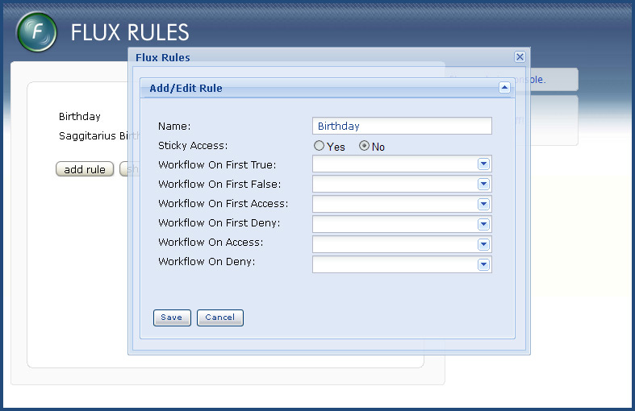
Flux

Slide 26
Flux
Eye-candy
(Flux Graph)‏

Slide 27
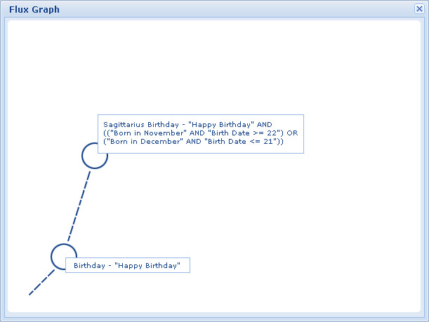
Flux

Slide 28
Flux
Current Status
Mostly functionally complete, passing all tests
https://svn.webgui.org/plainblack/branch/WebGUI_flux
No GUI (yet)‏
No serious Profiling/Benchmarking/Optimisation work done (yet)‏
Not used in production (yet)‏

Slide 29

Flux
The End

